Slide 1
Questions About Setting Up?
Azure Machine Learning

Slide 2
Disclaimer
By participating in Microsoft University Workshop Series 2021, you consent to photography, audio recording, video recording and its release, publication, exhibition, or reproduction to be used for news, web casts, promotional purposes, telecasts, advertising, inclusion on web sites, or for any other purpose(s) that Microsoft, its vendors, partners, affiliates and/or representatives deems fit to use. You release Microsoft, its officers and employees, and each and all persons involved from any liability connected with the taking, recording, digitizing, or publication of interviews, photographs, computer images, video and/or or sound recordings.​

Slide 3

University Workshop Series
Azure Machine Learning
James Lee Customer Engineer (Azure Data & AI)

Slide 4
What is Machine Learning ?
Using known data, develop a model to predict unknown data.
Notes:
Basic definition:
Machine learning develops algorithms for making predictions (statistical sense) from data *
Learning models from available training data, to make good predictions on unseen test data

Slide 5
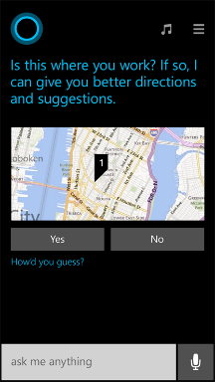
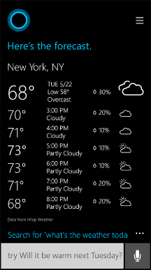
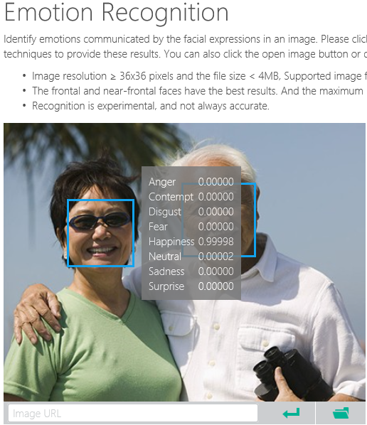
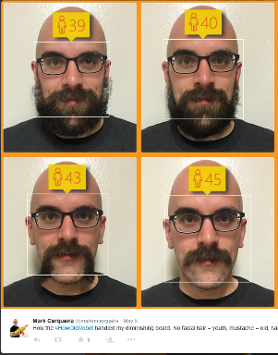
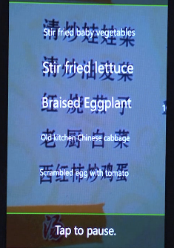
Why Machine Learning?
Notes:
Smart applications, services, platforms…
Digital Smart Personal Assistant
Image / Text / Data analyze

Slide 6
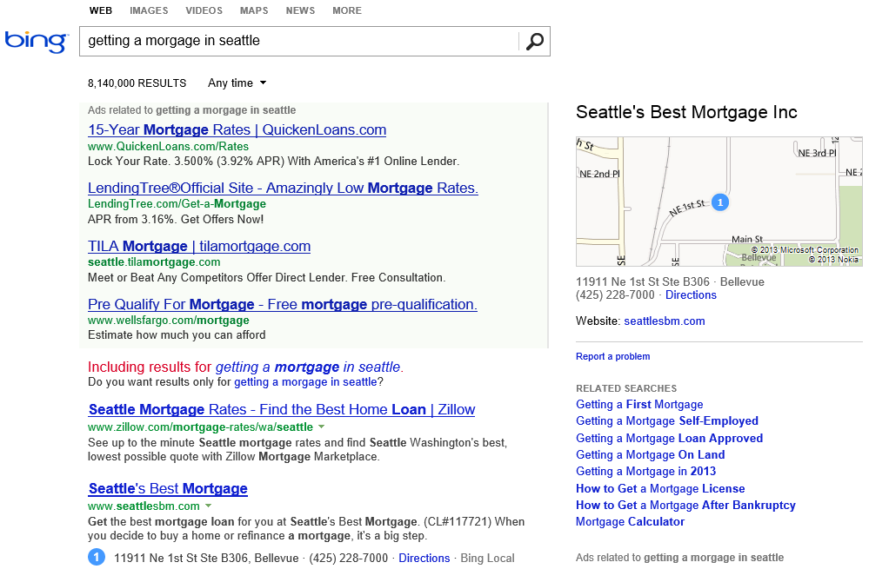
What is the probability of a click on each ad?
What language?
What is the intent?
Machine learning enables nearly every value proposition of web search.
Which ads to show, and in what order?
Are any of these pages malicious?
Misspelled?
What pages should we index?
What ad pricing will optimize revenue?
Which links are most likely to get clicked?
Notes:
The first “killer commercial application” of ML on Big Data was web search. With ML, we can use all of the billions of queries and associated clicks that we collect each month as training data for an ML system. That way, the system can learn, for each query, which web pages are likely the most relevant.
But the impact of ML goes beyond page relevance. With billions of queries, we can learn common misspellings and the native language of the user. We can discern the intent of the user – shopping? research? entertainment? ML can learn what kinds of pages are malicious.
ML also is able to learn, for each query, what kinds of ads are most likely to be clicked, and also learn how best to show the ads.
And even before we get to a real user, ML can be used to figure out what parts of the web are worth scanning, and what pricing for ads will optimize revenues.

Slide 7
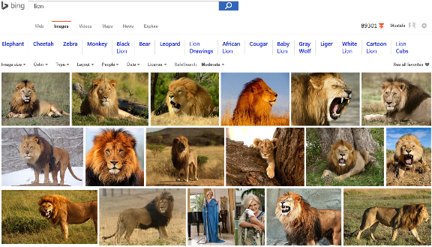
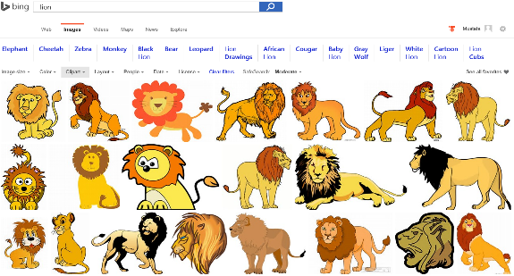
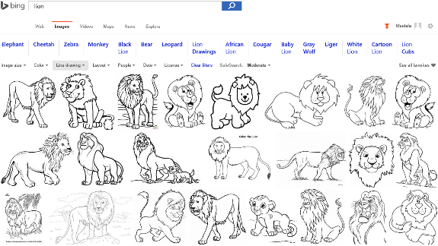
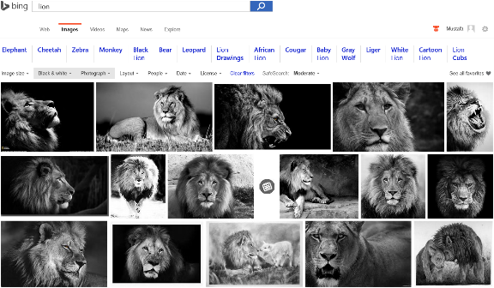
Image Analyze
Notes:
Search “lions” on Bing and change Image type etc. filters…
Behind the ML service categorizes the image db and returns the result.

Slide 8
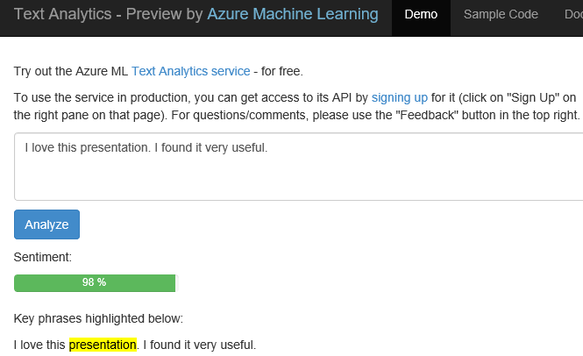
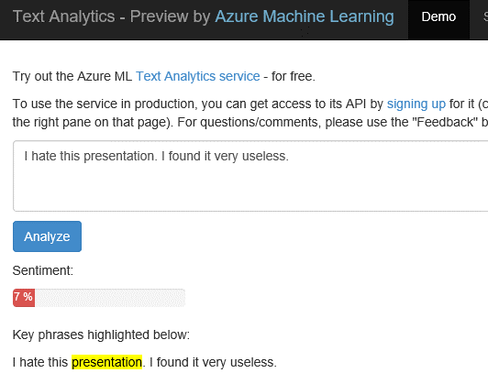
Text Analytics: User reviews
Positive
Negative
Notes:
Ready to use ML API published on Azure Datamarket place. A showcase of production ML solution in action (This can be used i.e. in shopping websites to see user reviews about a product etc.)
Test by yourself some of the reviews comments on Expedia or other online shopping sites. Copy/paste user comments to see the analyze result. If sentiment result shows higher percentage number, it means it is positive. If the percentage is low than it is a negative comment.
https://text-analytics-demo.azurewebsites.net/

Slide 9

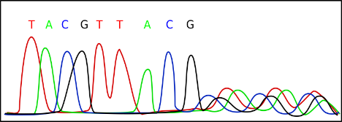
Data Science
Data Science is far too complex
Cost of accessing/using efficient ML algorithms is high
Comprehensive knowledge required on different tools/platforms to develop a complete ML project
Difficult to put the developed solution into a scalable production stage
Need a simpler/scalable method:
Azure Machine Learning Service
Notes:
Actually it is the science on data

Slide 10

Microsoft Azure Machine Learning
Make machine learning accessible to every enterprise, data scientist, developer, information worker, consumer, and device anywhere in the world.

Slide 11






Transform data into intelligent action
Information Management
Big Data Stores
Machine Learning and Analytics
Dashboards and Visualizations
Business apps
Power BI
Azure
Data Factory
Azure
Machine Learning
Personal Digital Assistant
Azure
Data Lake
Cortana
People
Custom apps
Azure
Data Catalog
Azure
HDInsight (Hadoop)
Perceptual Intelligence
Azure
SQL Data Warehouse
Face, vision
Speech, text
Azure
Event Hub
Azure
Stream Analytics
Business Scenarios
Sensors and devices
Recommendations,
customer churn,
forecasting, etc.
Automated Systems
DATA
INTELLIGENCE
ACTION

Slide 12
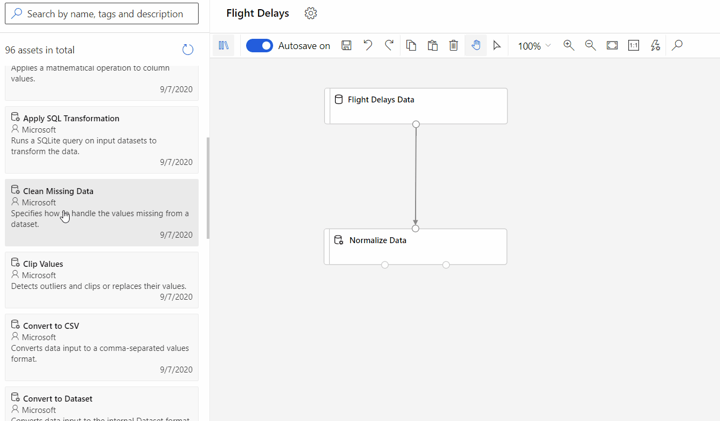
Microsoft Azure Machine Learning
Web based UI accessible from different browsers
Drag & Drop visual development of models
Automated Machine Learning (Today!)
Extend with R and Python scripts
Document with Jupyter notebooks
Deploy an API easily
Notes:
Lets look at some of the features of ML Studio

Slide 13

Example use cases
Finance and risk
Sales and marketing
Customer and channel
Operations and workforce
Revenue Forecasting
Sales forecasting
User segmentation
Agent allocation
$$$
Portfolio optimization
Demand forecasting
Personalized offers
Warehouse efficiency
Investment modelling
Sales lead scoring
Product recommendation
Smart buildings
$$$
Fraud detection
Marketing mix optimization
Predictive maintenance
Risk management
Supply chain optimization
Notes:
Confidential…
+ notes From the book: AzureMachineLearning – AzureFundamentals
Many examples of predictive analytics can be found literally everywhere today in our society:
Spam/junk email filters These are based on the content, headers, origins, and even user behaviors (for example, always delete emails from this sender).
Mortgage applications Typically, your mortgage loan and credit worthiness is determined by advanced predictive analytic algorithm engines.
Various forms of pattern recognition These include optical character recognition (OCR) for routing your daily postal mail, speech recognition on your smart phone, and even facial recognition for advanced security systems.
Life insurance Examples include calculating mortality rates, life expectancy, premiums, and payouts.
Medical insurance Insurers attempt to determine future medical expenses based on historical medical claims and similar patient backgrounds.
Liability/property insurance Companies can analyze coverage risks for automobile and home owners based on demographics.
Credit card fraud detection This process is based on usage and activity patterns. In the past year, the number of credit card transactions has topped 1 billion. The popularity of contactless payments via near-field communications (NFC) has also increased dramatically over the past year due to smart phone integration.
Airline flights Airlines calculate fees, schedules, and revenues based on prior air travel patterns and flight data.
Web search page results Predictive analytics help determine which ads, recommendations, and display sequences to render on the page.
Predictive maintenance This is used with almost everything we can monitor: planes, trains, elevators, cars, and yes, even data centers.
Health care Predictive analytics are in widespread use to help determine patient outcomes and future care based on historical data and pattern matching across similar patient data sets.

Slide 14
Workshop

Slide 15
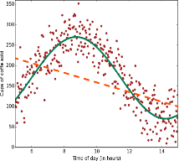
Regression
Scenarios:
Stock prices prediction
Sales forecasts
Premiums on insurance based on different factors
Quality control: number of complaints over time based on product specs, utilization, etc.
Workforce prediction
Workload prediction
Algorithms: Bayesian Linear, Linear Regression, Ordinal Regression, ANN, Boosted Decision Tree, Decision Forest
Regression

Slide 16
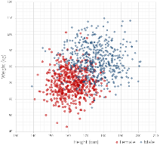
Classification
Scenarios:
Which customer are more likely to buy, stay, leave (churn analysis)
Which transactions|actions are fraudulent
Which quotes are more likely to become orders
Recognition of patterns: speech, speaker, image, movement, etc.
Algorithms: Boosted Decision Tree, Decision Forest, Decision Jungle, Logistic Regression, SVM, ANN, etc.
Classification

Slide 17
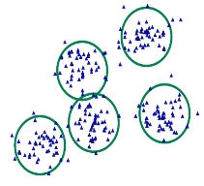
Clustering
Scenarios:
Customer segmentation: divide a customer base into groups of individuals that are similar in specific ways relevant to marketing, such as age, gender, interests, spending habits, etc.
Market segmentation
Quantization of all sorts, such as, data compression, color reduction, etc.
Pattern recognition
Algorithms: K-means
Clustering

Slide 18
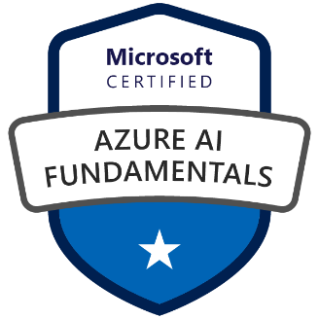
Certifications
Student Discounts
AI-900: Microsoft Azure AI Fundamentals
Azure ML Designer
Computer Vision
Natural Language Processing
Chatbots
Price: USD$15 (usual USD$106). Ends in Dec 2021.

Slide 19
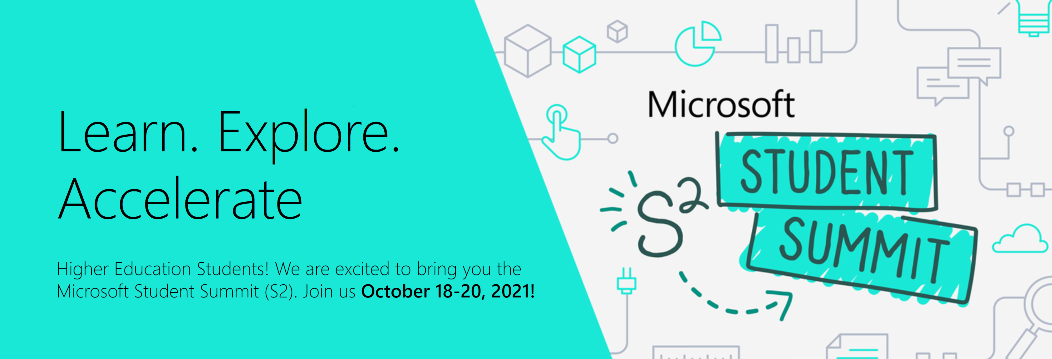
Microsoft Student Summit
18 Oct – 20 Oct 2021
Notes:
https://www.microsoft.com/en-us/education/s2-student-summit
LEARN from Microsoft executives, EXPLORE the latest on Microsoft technologies and ACCELERATE their path by skilling up and raising their profile.
Each day offers 2 hours of keynote sessions covering a variety of topics including executive insights, tech tools, and career advice.
We’ve also made it easy to get ready for Microsoft certification by offering additional daily 4-hour exam cram sessions aligned to Microsoft’s Fundamentals certifications – featuring Azure Data, Security, Identity & Compliance and Power Platform!

Slide 20
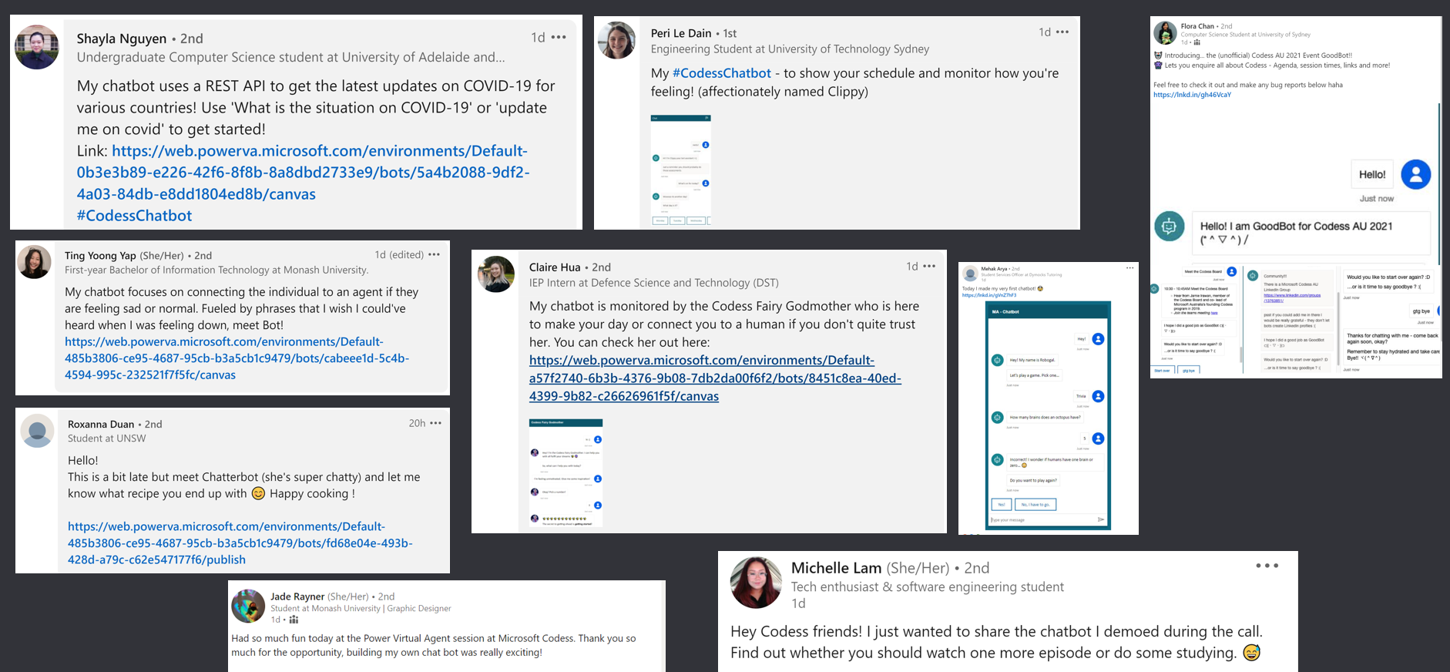
Share on your LinkedIn!

Slide 21
Feedback Form

